Slide 1
ATM Simulation
(Mini Project)

Slide 2
Group Members
Name | Roll No.
Jayprakash Mahto | CSE/086/20
Vishal Sharma | CSE/092/20
Raj Pandey | CSE/074/20
Vikash Mundari | CSE/076/20
Anand Kumar Shaw | CSE/112/20
Under the guidance of: Prof. Murari Krishna Saha

Slide 3
Index
Title | Page No.
Introduction | 4
Uses of an ATM | 5
Pros & Cons of an ATM | 6
Project Introduction | 7
Technologies used | 8
Different Functions of the project | 9-14
Furture updates in the project | 15

Slide 4
Introduction
An ATM stands for automated teller machine, is a specialized computer that makes it convenient to manage a bank account holder’s funds.
It allows a person to check account balances, withdraw or deposit money, print a statement of account activities or transactions.
ATMs were first used in London in 1967, and after 50 years, these machines can be found nationwide.

Slide 5
Uses of an ATM
Check balance: A person can cheque his bank balance without going to bank and standing on queue. This can save time of the person.
Withdraw money: A person can withdraw money from his bank account from anywhere around the world.
Deposit money: A person can also deposit his savings in the atm without going to bank.

Slide 6
Pros & Cons of ATM
Advantages | Disadvantages
Less time, effort required | Charges fees
Offers 24x7 Service | Limitations on cash withdrawal
Reduce bank workload | Possibility of frauds
Access to bank account from anywhere | Non-reachable in rural areas

Slide 7
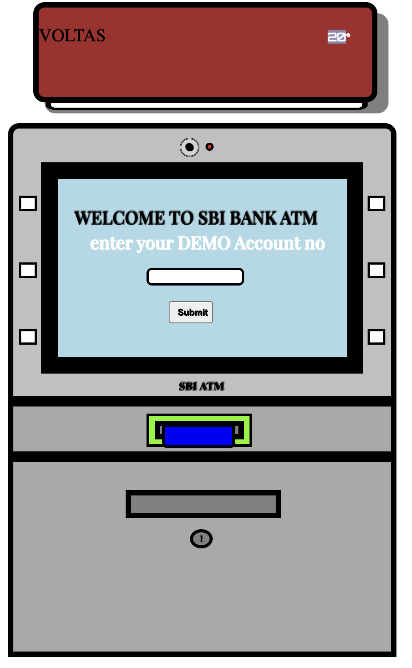
Project introduction
Our project contains an ATM Simulation Web Design. Which is made using tools named HTML, CSS, JavaScript.
For this project we created an atm machine using div in html and absolutely fixing their position in the page. And for adding colours in the web page we used css. And for different functions of the machine like clicking on the button, withdraw, deposit, account details we use javascript to change the div and display the respective views.

Slide 8
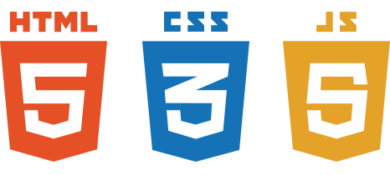
Technologies used
Softwares used

Slide 9
Different Functions of the project.

Slide 10
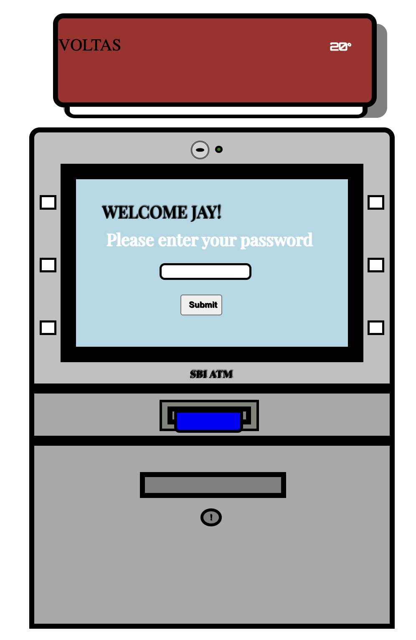
Login Page
First user has to insert the account password to continue to further options.

Slide 11
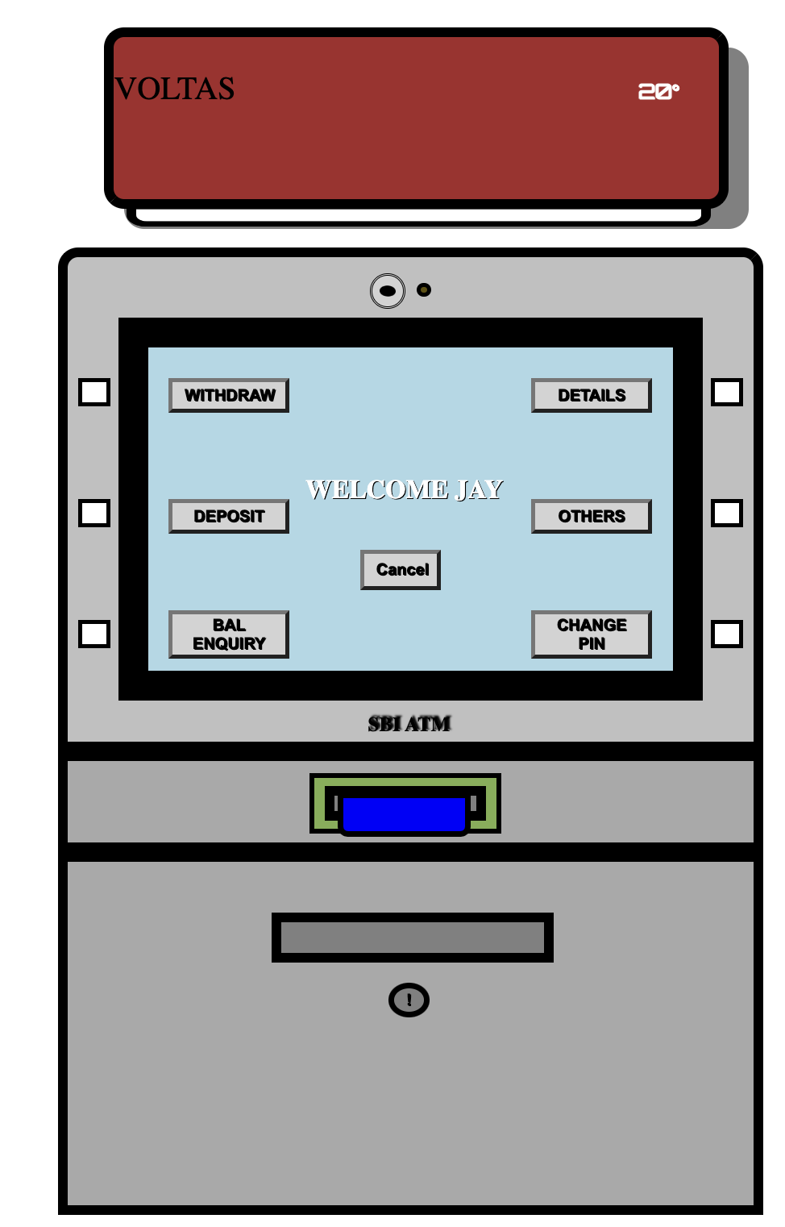
User options
After successfully logging in, User has the access to all the functions like:
Withdrawing money
Depositing money
Balance enquiry
Account Details

Slide 12
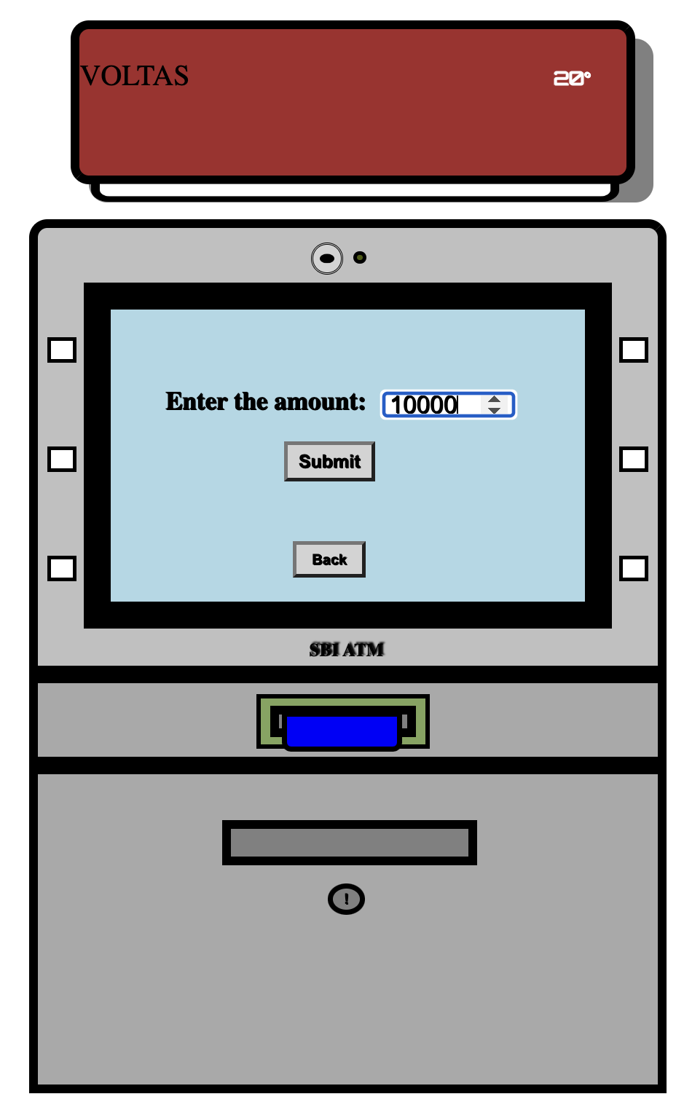
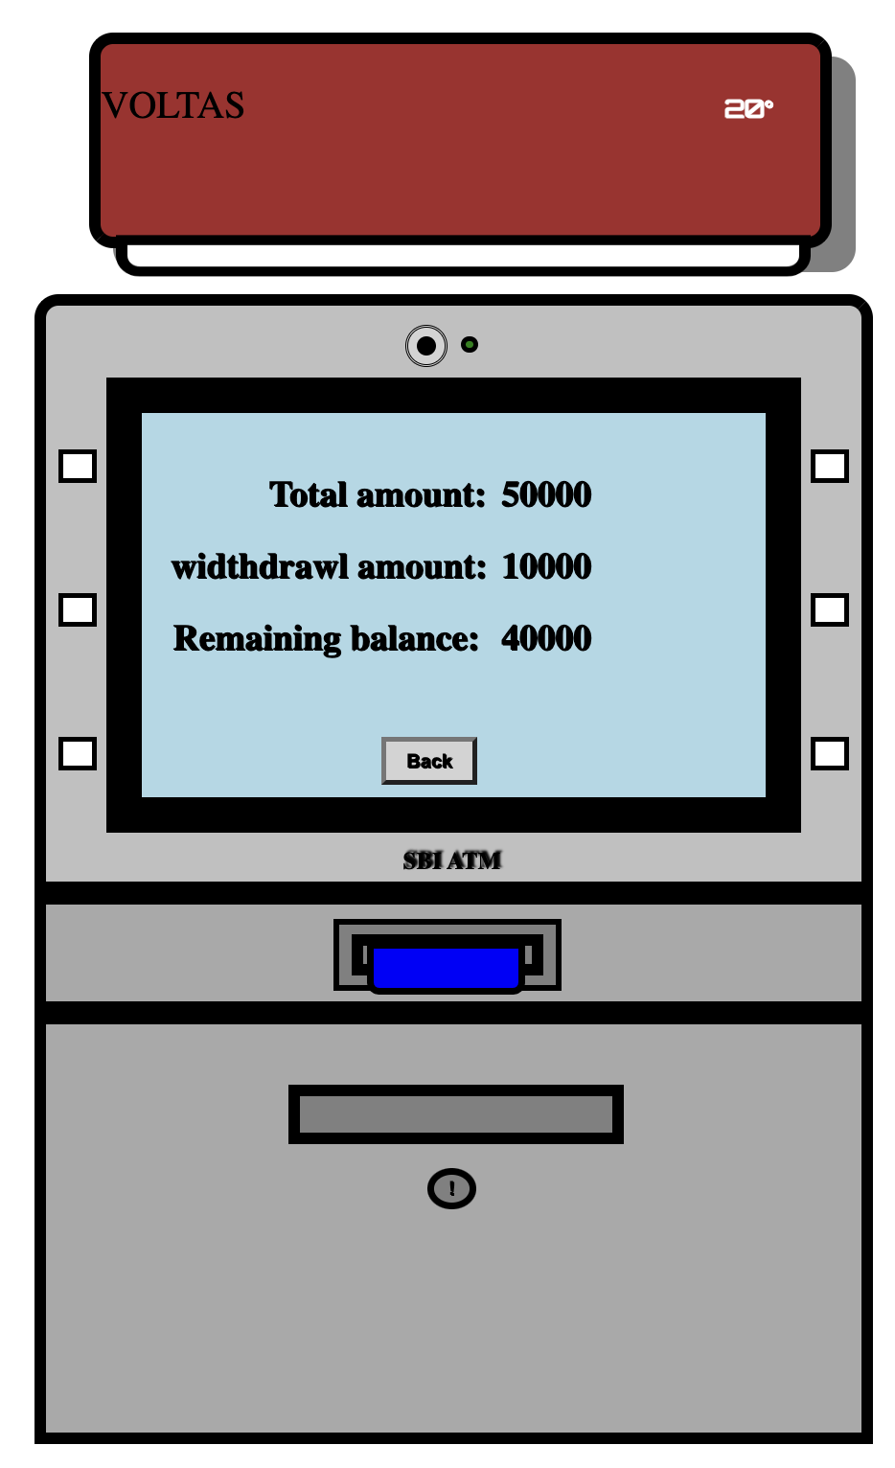
Withdraw Money
To withdraw the money user has to enter the account of money he wants to withdraw.
If user account has enough money, the atm will display withdraw successful message and also show remaining balance.
If user doesn’t has enough amount in account then the atm will reject the withdraw request.

Slide 13
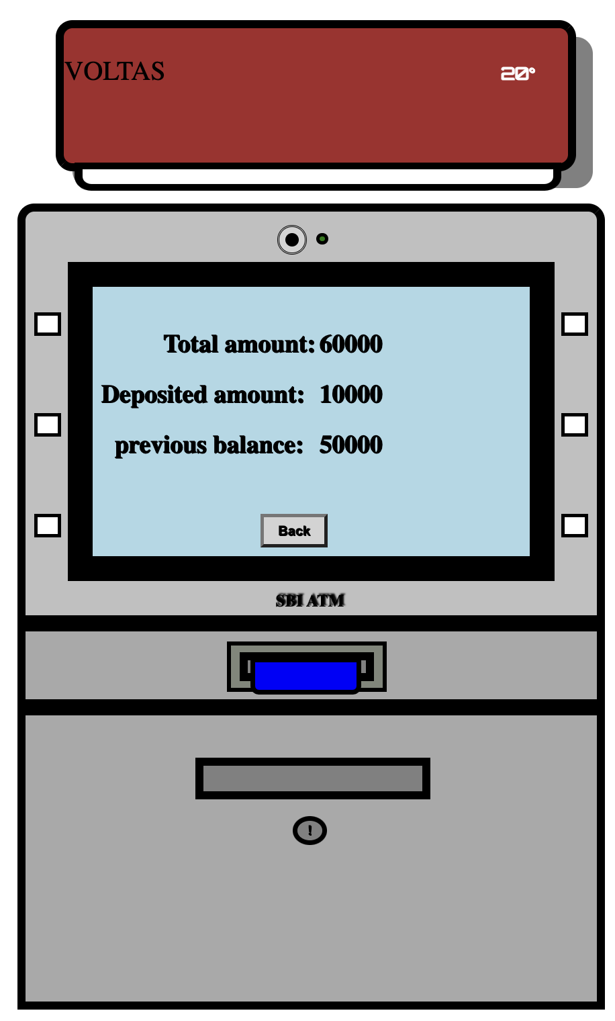
Deposit Money
To deposit money into your account, you have to insert the amount of money you want to deposit.
After entering the amount, The system will display the updated account information like updated balance and previous balance.

Slide 14
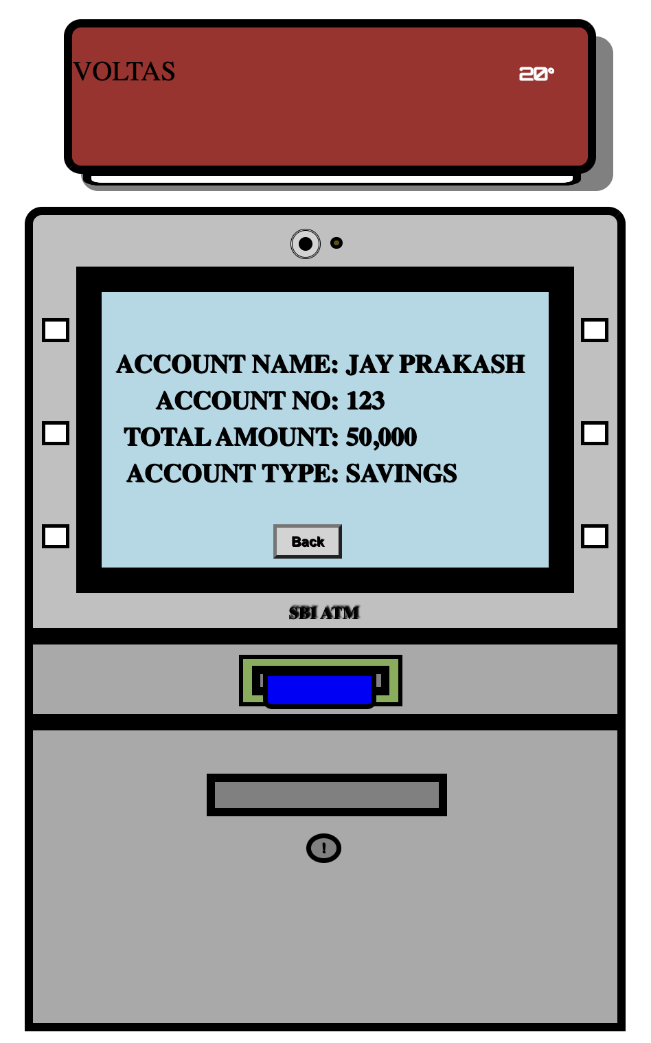
Account
Information
User can also see his account details on the system by selecting the account details button on the option menu.
User can see information like name, account number, account type, total balance.

Slide 15
Future updates in the project:
Multiple user management: Currently we are managing only one user account, but we will later add multiple user option.
For special abled person there will be voice control for their ease to use.

Slide 16
Reference:
W3 html tutorials (https://www.w3schools.com/html/)
W3 css tutorials (https://www.w3schools.com/css/default.asp)
W3 js tutorials (https://www.w3schools.com/js/default.asp)
Learning Web Design, Book by: Jennifer Niederst Robbins, Published by: O’Reilly
Web Designing Tutorials on Youtube by CodeWithHarry (https://www.youtube.com/playlist?list=PLu0W_9lII9agiCUZYRsvtGTXdxkzPyItg)
ATM machine wikipedia (https://en.wikipedia.org/wiki/Automated_teller_machine)

Slide 17
Thank You!

